Slide 1
Internet
192.168.15.X/24: NAT (Server LAN)
192.168.11.X/24: Host-only (a small LAN of Client-Server)
192.168.1.XX /Gateway to Internet
192.168.11.1
Host Machine
192.168.15.1
192.168.15.2
NAT-Router
VMnet 8 (NAT)
VMnet 1 (Host-only)
VM Server
VM Client
192.168.15.10
192.168.11.10
192.168.11.XX

Slide 2
Objectives
Set up environment in VMWare workstation/ Virtual Box with discussed network IP addresses ( 2 LANs: Server LAN/ NAT and Client-Server LAN/ Host-only).
In VMWare Workstation: follow instructions in PDF file: Chapter 1.
Install Ubuntu Server on a VM
Set Static IP address to your Ubuntu Server and make sure it can connect to the Internet just by setting IP address and nameserver addresses.
Use ip a to show network interface and IP addresses
To set ip address: edit configuration file in /etc/netplan/00-installer-config.ymal

Slide 3
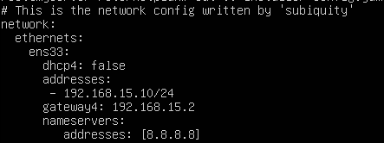
Set Static IP address to your Ubuntu Server and make sure it can connect to the Internet just by setting IP address and nameserver addresses.
Use ip a to show network interface and IP addresses
Switch to root user using: sudo su
To set ip address: edit configuration file in /etc/netplan/00-installer-config.ymal
Run sudo netplan apply to apply configuration file.

Slide 4
Ping google.com to test connection

Slide 5
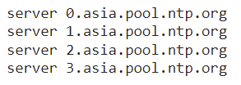
Installing and Configuring NTP
Install ntp: sudo apt install ntp
Configure: edit config file /etc/ntp.conf and replace with Asia timezone server
Restart service: sudo systemctl restart ntp
Check status: sudo systemctl status ntp
GO TO Client
Install ntpdate on Client: go to client and type: sudo apt install ntpdate
Edit hostfile: sudo vi /etc/hosts
Add 192.168.11.10 servername
sudo ntpdate servername
sudo ufw allow 123/udp

Slide 6
Installing and Configuring NTP Client
sudo apt install ntp
vi /etc/ntp.conf
Add server servername prefer iburst
sudo systemctl restart ntp
ntpq -p

Slide 7
Configuring DHCP
1. Install and configure isc-dhcp-server on the server:
install:
sudo apt install isc-dhcp-server
Edit config file at /etc/default/isc-dhcp-server :
sudo nano /etc/default/isc-dhcp-server
Add name of network interface that we want it to become DHCP server address (Host-only)
for example if ens34 is the name of that interface.
INTERFACEv4=“ens34”
Edit the config file at /etc/dhcp/dhcpd.conf:
sudo nano /etc/dhcp/dhcpd.conf

Slide 8
Configuring DHCP
Add the following lines:
subnet 192.168.11.0 netmask 255.255.255.0 {
range 192.168.11.100 192.168.11.200;
option domain-name-servers 8.8.8.8;
option domain-name “google.com”;
option subnet-mask 255.255.255.0;
option routers 192.168.12.10;
default-lease-time 620;
max-lease-time 7200;
}
Start the service:
sudo systemctl start isc-dhcp-server

Slide 9
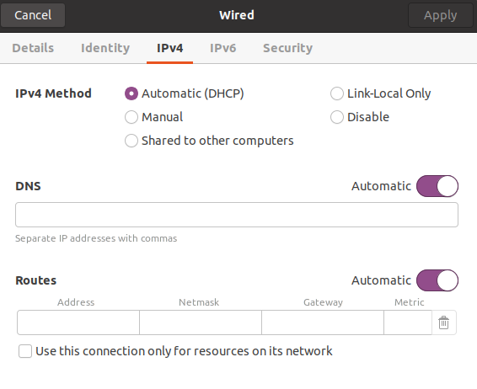
Configuring DHCP
Go to client and choose DHCP option on its Host-only interface.
Check its IP address to confirm if DHCP works.

Slide 10
Configuring router
1. Enable packet forwarding:
Edit config file:
sudo nano /etc/sysctl.conf
Uncomment :
net.ipv4.ip_forward=1
Apply change:
sysctl -p
2. Configuring Packet Forwarding and IP masquerading:
iptables -A FORWARD -i enp0s8 -o enp0s3 -j ACCEPT
enp0s8 is the name of network interface “Host-only”
enp0s3 is the name of network interface “NAT”
The above command will forward packets from Host-only interface to NAT interface.

Slide 11
Configuring Packet Forwarding and IP masquerading ( Continue ):
Now we want to configure packets from NAT interface to be forwarded back to Host-only interface.
Type:
iptables -A FORWARD -i enp0s3 -o enp0s8 -m state --state RELATED,ESTABLISHED -j ACCEPT
enp0s8 is the name of network interface “Host-only”
enp0s3 is the name of net work interface “NAT”
Configuring NATing: Now we want to allow all interfaces to use NAT
iptables -t nat -A POSTROUTING -o enp0s3 -j MASQUERADE
iptables -t nat -A POSTROUTING -o enp0s8 -j MASQUERADE

